Slide 1
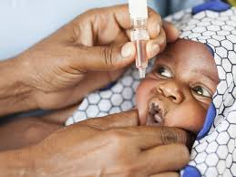
Child Vaccination Schedule Assistant
Empowering healthcare providers & parents with technology

Slide 2
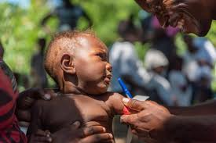
Problem Statement
In many communities, children miss vital vaccines simply because there's no easy way to keep track.
🧸 Ever forgotten a shot date? 📆 Not sure what comes next? 😟 Worried about side effects but nowhere to log them?
You're not alone — and that's exactly why this assistant was built.
✅ One place to track schedules, 🛡️ Learn what each vaccine does, 💬 Log reactions, Let’s protect their future — one vaccine at a time.

Slide 3
Target Audience
- Parents and guardians of children below 18 years
- Community health workers and clinics
- NGOs and government health initiatives
- Public health researchers and data analysts

Slide 4
Our Solution
An interactive platform that allows:
- Child registration with birthdate and vaccination data
- Visualization of vaccine schedules
- Real-time tracking of completed, due, and overdue vaccines
- Logging of vaccine reactions
- Auto-generated reports and trends
- AI-based vaccine assistant for FAQs

Slide 5
Core Features
✅ Secure Email + PIN Login
✅ Child Registration and Vaccine Tracking
✅ Post-vaccination Reaction Logging
✅ Export to PDF and CSV Reports
✅ Trends Dashboard
✅ AI Vaccine Assistant
✅ KEPI Schedule Awareness

Slide 6
Stretch Goal: Twilio Integration
📲 Integrate SMS reminders for:
- Upcoming vaccinations
- Missed doses
- Reactions follow-ups
🔧 Configuration:
- Secure Twilio credentials
- Schedule SMS using Twilio Client API

Slide 7

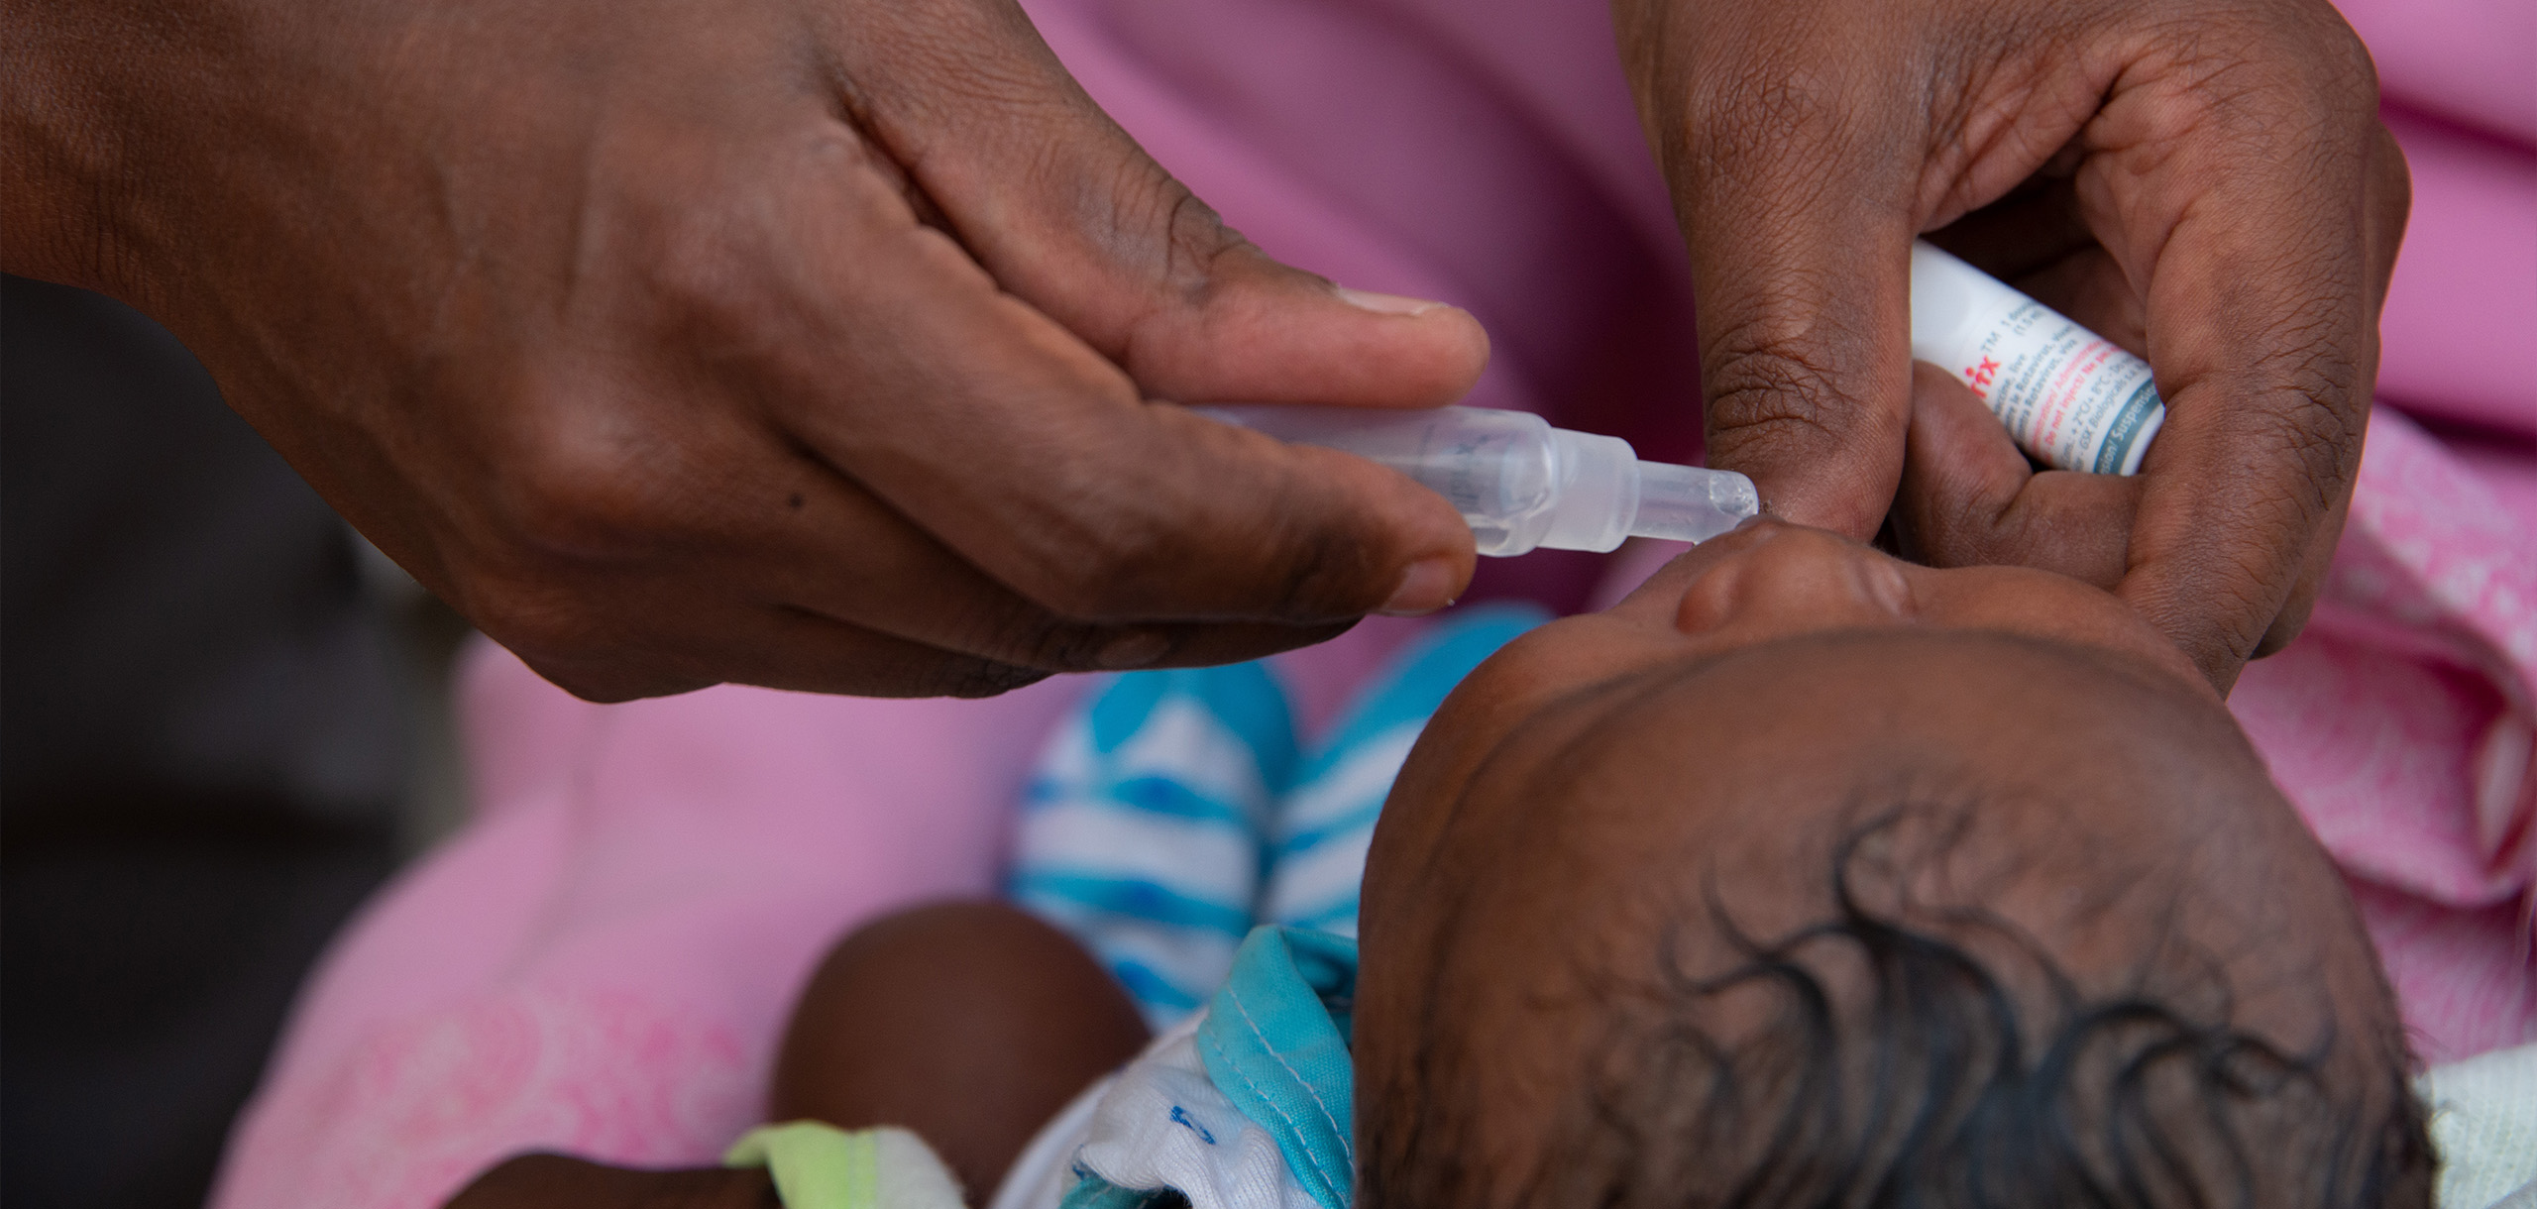
📊 Visual: Dashboard Overview / Trends Chart

